Slide 1
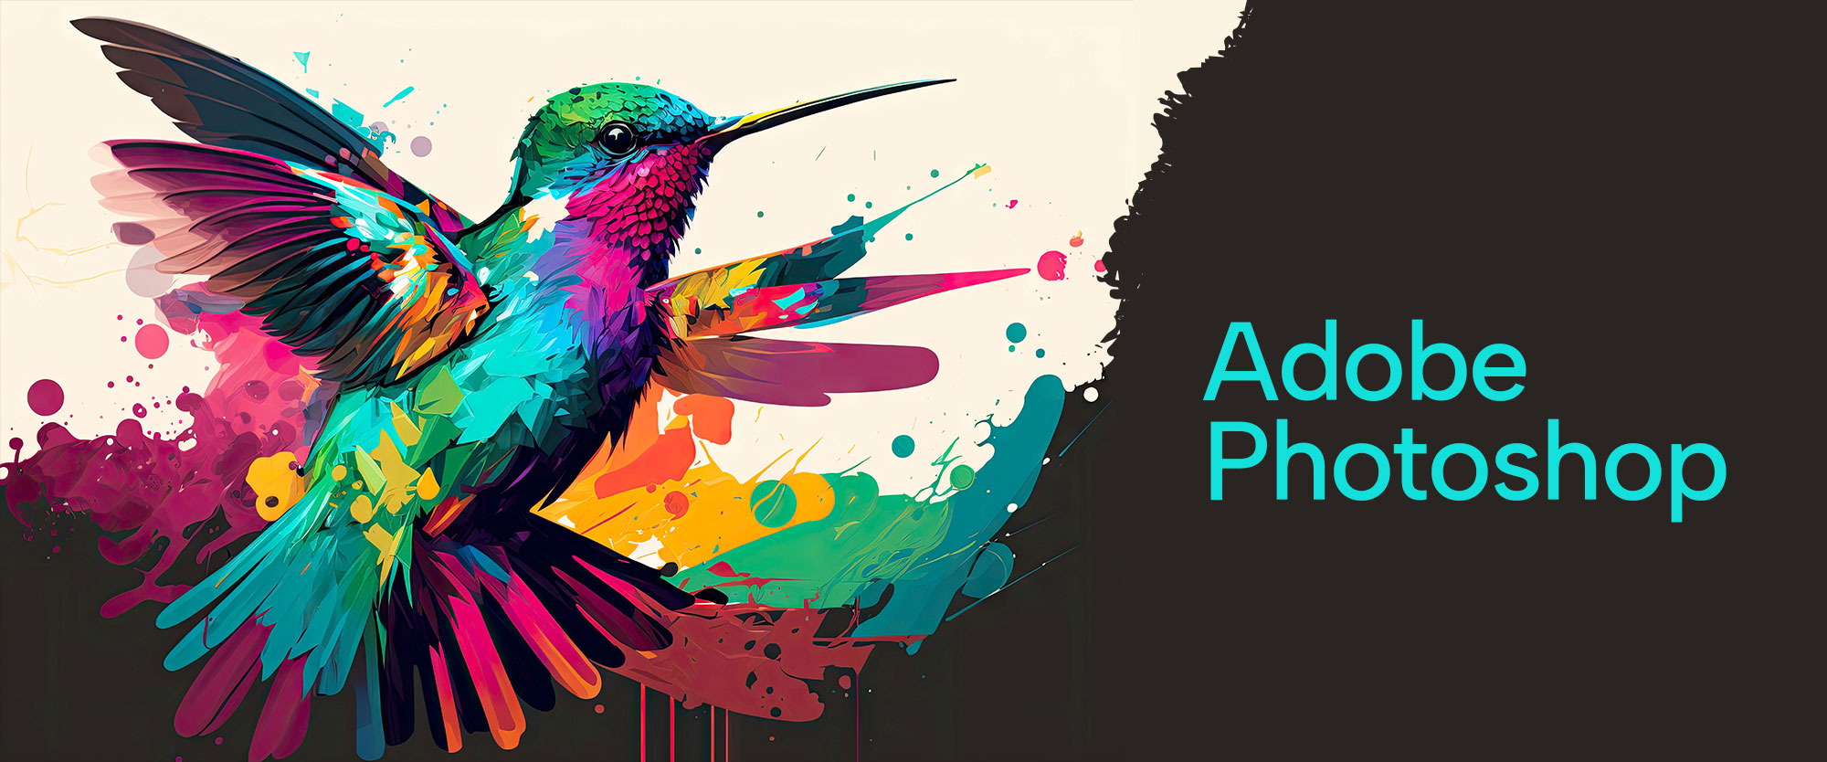

Slide 2
About today…
Advanced Color Correction
Gradients

Slide 3
Introduction to Advanced Color Correction
What is Color Correction?
Adjusting and enhancing the colors in an image to achieve a more accurate, vibrant, or stylistically appropriate look
Importance of Color Correction
Critical for creating visually appealing images in photography, design, and media production
Advanced vs. Basic Correction
Advanced techniques allow for precise control over specific colors, tones, and lighting, beyond simple adjustments like brightness or contrast

Slide 4
Tools for Color Correction
Curves Adjustment
Purpose
Allows for precise adjustments to the tonal range of an image
How to use
Modify the curve to adjust highlights, midtones, and shadows separately
Levels Adjustment
Purpose
Adjusts the brightness and contrast by setting the black, gray, and white points
How to use
Drag the sliders to improve image contrast and brightness
Hue/Saturation
Purpose
Adjusts the hue, saturation, and lightness of individual colors or the entire image
How to use
Select a color range to target and adjust the sliders accordingly
Color Balance
Purpose
Shifts the color balance of an image toward different tones (shadows, midtones, highlights)
How to use
Allows for precise adjustments to the tonal range of an image

Slide 5
Working with Curves Adjustment
Understanding the Curves Graph
Horizontal Axis
Represents the input levels (original brightness)
Vertical Axis
Represents the output levels (adjusted brightness)
Adjusting Tonal Ranges
Highlights
Adjust the top right of the curve to affect the brightest areas
Shadows
Adjust the bottom left to darken or lighten shadows
Midtones
Adjust the central curve for overall brightness and contrast
Practical Example
How to correct a washed-out image by adjusting the midtones and shadows using the Curves tool

Slide 6
Using Levels for Contrast Enhancement
Setting Black, White, and Gray Points
Black Point
Sets the darkest part of the image to pure black
White Point
Sets the lightest part of the image to pure white
Gray Point
Adjusts the midtones for balanced contrast
Improving Image Depth
Moving the Black and White Sliders
Increases contrast and depth by expanding the tonal range
Output Levels
Fine-tunes the overall brightness and darkness without altering contrast
Practical Example
How to use Levels to fix an image with poor contrast, making colors more vivid

Slide 7
Precision Color Adjustment with Hue/Saturation
Selective Color Adjustments
Targeting Specific Colors
Use the dropdown menu to select a specific color range for adjustment
Adjusting Hue
Change the actual color of the selected range
Adjusting Saturation
Increase or decrease the intensity of the color
Adjusting Lightness:
Modify the brightness of the color range
Desaturation Techniques
Partial Desaturation
Apply desaturation to certain areas or colors while leaving others vivid
Complete Desaturation
Convert the image to grayscale using the Saturation slider
Practical Example
Adjusting the saturation of a landscape photo to make the sky bluer while keeping the foreground natural

Slide 8
Advanced Color Balance Adjustments
Correcting Color Casts
Shadow, Midtone, and Highlight Adjustments
Use the dropdown menu to select a specific color range for adjustment
Adding Warmth or Coolness
Shift the balance toward red/yellow for warmth or blue/cyan for coolness
Creating Mood with Color
Use Color Balance to set the mood of an image (e.g., cool tones for a winter scene, warm tones for a sunset)
Practical Example
Correcting a photo with a greenish tint by adjusting the Color Balance in the midtones and highlights

Slide 9
Introduction to Gradients
What are Gradients?
A gradual transition between two or more colors, used to create depth, lighting effects, or color blending in designs
Types of Gradients
Linear Gradient
Color transition along a straight line
Radial Gradient
Transition from the center outwards in a circular pattern
Angle Gradient
Rotates colors around a point in a circular direction
Reflected Gradient
Symmetrical gradient mirrored from a central line
Diamond Gradient
Transition outward from a central diamond shape
Common Uses of Gradients
Backgrounds, shading, light effects, and transitions between images or layers

Slide 10
Creating and Applying Gradients
Using the Gradient Tool
Basic Gradient Application
Select the Gradient Tool, choose a gradient from the options, and drag across the canvas
Customizing Gradients
Modify colors, opacity, and gradient stops in the Gradient Editor
Reversing Gradients
Toggle the Reverse checkbox to flip the gradient direction
Gradient Overlay Layer Style
How to Apply
Add a Gradient Overlay to any layer via the Layer Styles panel
Customizing the Overlay
Adjust the blend mode, opacity, and scale for different effects
Practical Example
Creating a soft light effect by applying a radial gradient as an overlay on a background image

Slide 11
Combining Color Correction and Gradients
Enhancing Corrections with Gradients
Background Enhancements
Use gradients to enhance or replace dull backgrounds
Lighting Effects
Create custom lighting by combining color correction
with gradients for highlights and shadows
Gradient Filters
Apply gradient filters after color correction to add a final stylistic touch, such as vignettes or color overlays
Practical Example
Combining Curves adjustment for contrast with a gradient overlay to enhance the overall mood of an image

Slide 12
Common Mistakes and Tips
Common Mistakes
Over-Editing Colors
Excessive adjustments can lead to unrealistic hues and loss of detail
Banding in Gradients
Visible lines or stripes due to insufficient bit depth
Incorrect Color Balance
Unnatural color casts and imbalanced hues
Inconsistent Gradients
Harsh transitions or mismatched gradient effects
Ignoring Layer Order
Misplaced layers causing visibility and blending issues
Tips for Success
Use Adjustment Layers
Make non-destructive edits and keep color changes subtle
Apply Color Balance Layers
Adjust shadows, midtones & highlights separately for accurate color correction
Fine-Tune Gradient Settings
Ensure smooth transitions by carefully adjusting gradient stops and using blending modes

Slide 13
Practical Exercise
Task
Enhance an image using advanced color correction techniques and apply gradients to improve the visual impact
Instructions
Start with an image that needs color correction (e.g., underexposed or with a color cast)
Use Curves, Levels, and Color Balance to correct the colors and improve contrast
Apply a gradient overlay to add depth or lighting effects
Experiment with Gradient Maps to create a unique color style
Use layer masks and gradients to blend different parts of the image smoothly
Goal
Create a polished, visually striking image that demonstrates mastery of both color correction and gradient techniques

